Slide 1
A user guide to transformers
Martin Sundin, Lead Data Scientist at LYTT
Data Science Festival Summer School 2023

Slide 2

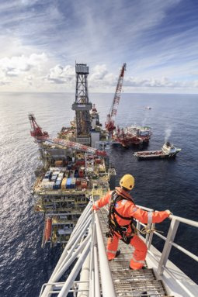

Lead Data Scientist at
LYTT is a sensor data platform and analytics company.
Enabling companies to better understand how their equipment operates, so they can make better informed decisions to improve safety and reduce environmental impact.
Making the invisible visible. About 65 employees.
All opinions expressed in this presentation are solely my own opinions and does not reflect the opinions of LYTT Ltd. or its affiliated companies.
Kudos to my colleague Ricardo Margarido for providing valuable feedback for this presentation.

Slide 3
What are Transformers?

Slide 4
What are transformers?
Output
Dense
Decoder
Dense
Transformers is a deep-learning sequence-to-sequence architecture.
Good for modelling sequences with long-range correlations (like NLP) and for transfer learning,
Earlier approaches are to use RNNs or LSTMs.
Famous architectures: BERT, T5, GPT.
Encoder
Dense
Attention
Attention
Attention
Positional Encoding
Positional Encoding
Embedding
Embedding
Inputs
Output

Slide 5
Why give this talk?

Slide 6
Why have this talk?
Standard approach to learning new things:
Get an overview
Get an understanding of the basics
Try a simple example
Try a slightly more complicated example
Do the real thing
Keep learning
Student
User
Practitioner

Slide 7
Disconnect in literature
Subject | Number of articles
Transformers explained | ~10 000
Transformers from scratch | ~1 000
Simple example of transformers | < 10
Transformers for time-series | < 5
(Pretrained) Transformers for NLP | ~5 000
Large Language Models | 1 200 000 000
ChatGPT | 1 590 000 000
Why this gap? What to do?

Slide 8
What to do?
Complain that there is no good resources
What I want to do
Several posts and at least one 1 article on this*, **
Just did it.
Write the article/talk you wanted to read/hear
What I should do
Why we are here
*jamesmccaffrey.wordpress.com/2022/08/25/pytorch-transformer-sequence-to-sequence-good-examples-are-hard-to-find/
**jamesmccaffrey.wordpress.com/2022/09/09/simplest-transformer-seq-to-seq-example/

Slide 9
What to do?
"If you find a book you really want to read but it hasn’t been written yet, then you must write it." - Toni Morrison
"If you find a talk you really want to hear but it hasn’t been given yet, then you must give it." - (Inspired by) Toni Morrison

Slide 10
What are transformers?
And how do we use them

Slide 11
What are transformers?
Next token (Sequence)
Understanding (Sequence)
Encoder
Decoder
"Understanding"
"Prediction"
Memory
Sequence
Sequence

Slide 12
Encoder Models
How to classify sequences with a transformer encoder model

Slide 13
How to classify with encoders?
Understanding (Sequence)
Pooling
Dense
Label (vector)
Encoder
Pre-processing
Sequence

Slide 14
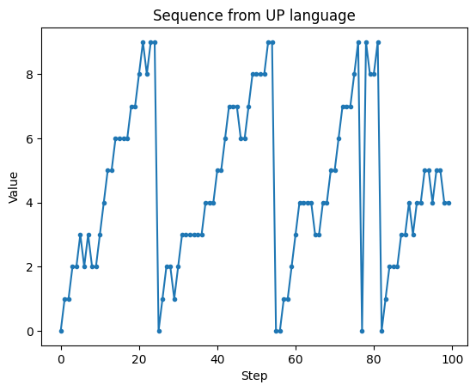
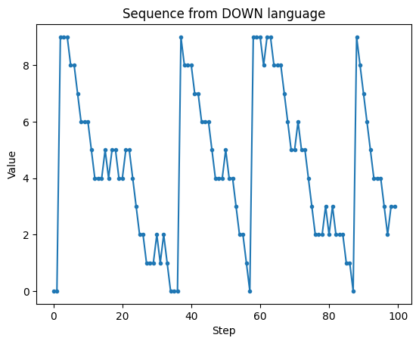
Toy example
Consider two toy sequences.
UP which is a sequence that mostly increases and wraps around at 10.
DOWN which is a sequence that mostly decreases and wraps around at 10.
We want to classify if a sequence is UP or DOWN.

Slide 15
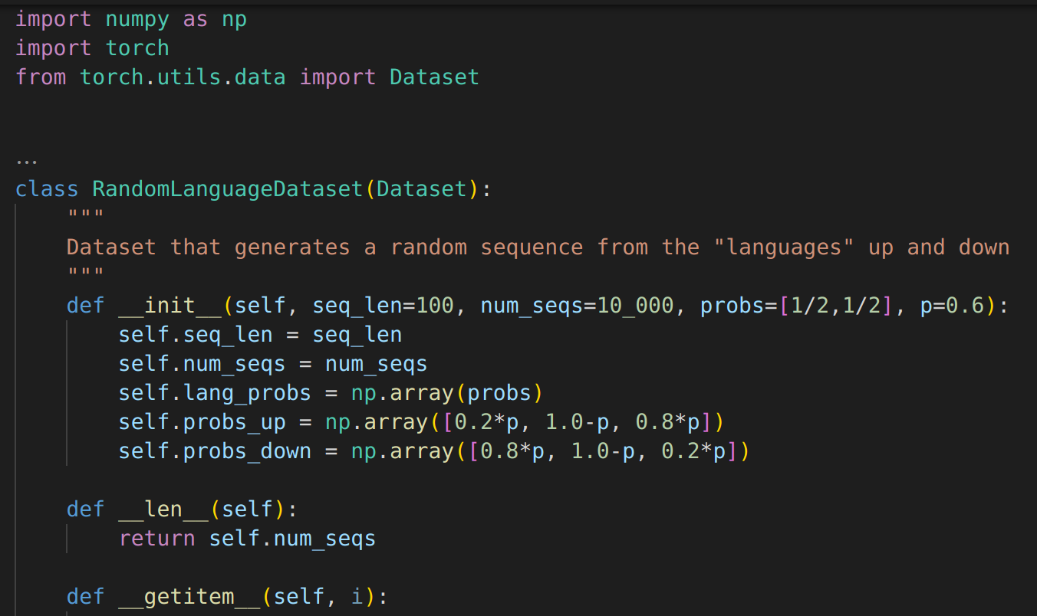
Pytorch Dataset

Slide 16
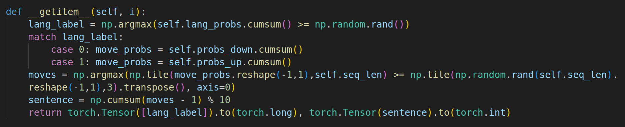
Pytorch Dataset
Output shape: (1,), (seq_len,)

Slide 17
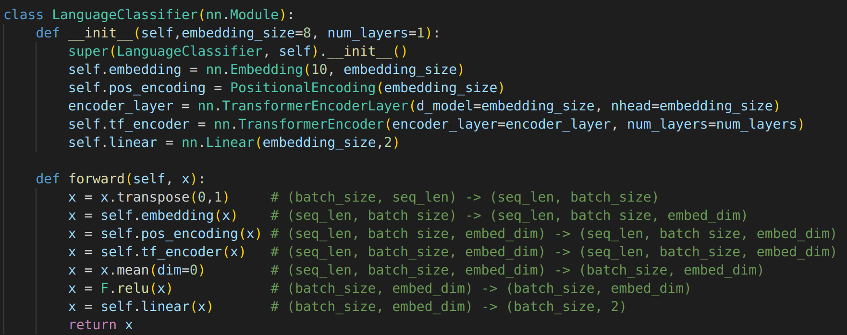
Model for token sequence
Inference: (batch_size, seq_len) -> (batch_size, 2)

Slide 18
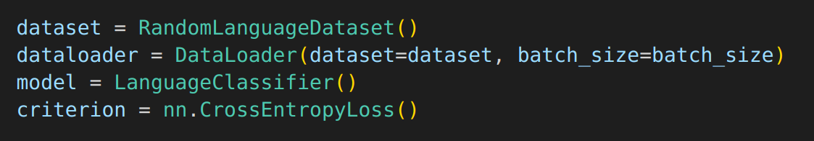
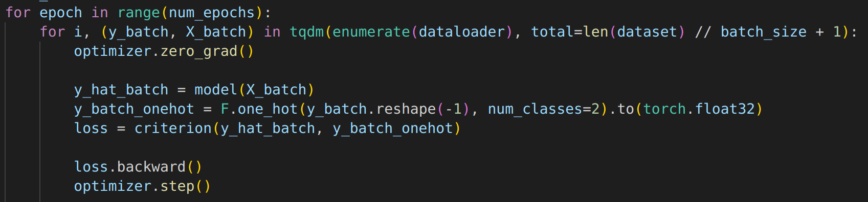
Training loop

Slide 19
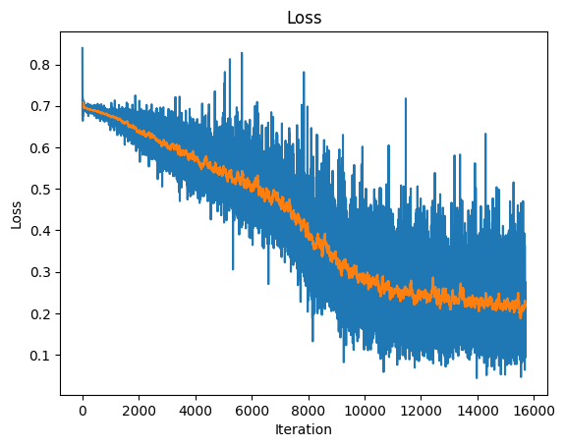
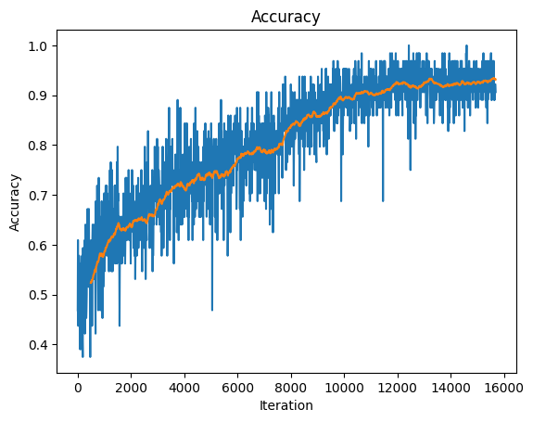
Training results

Slide 20
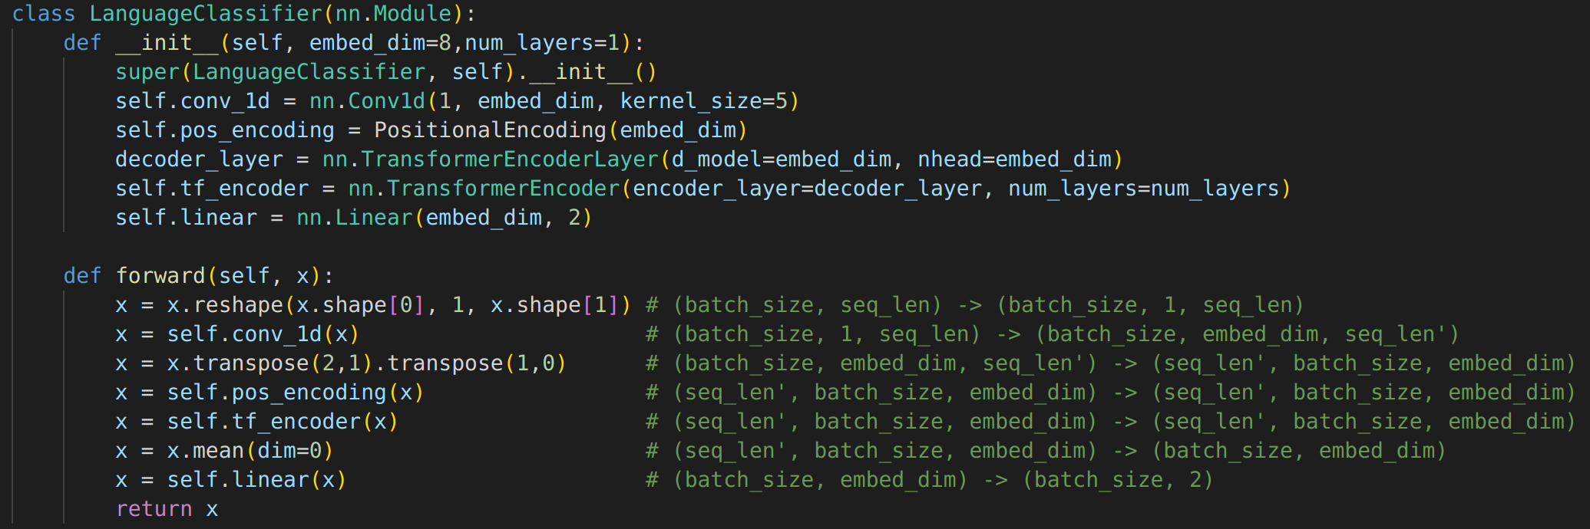
Timeseries classification example
Inference: (batch_size, seq_len) -> (batch_size, 2)

Slide 21
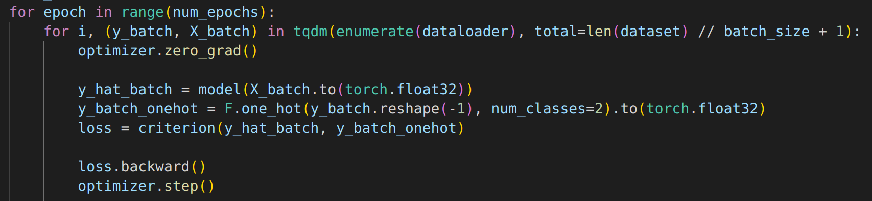
Training loop

Slide 22
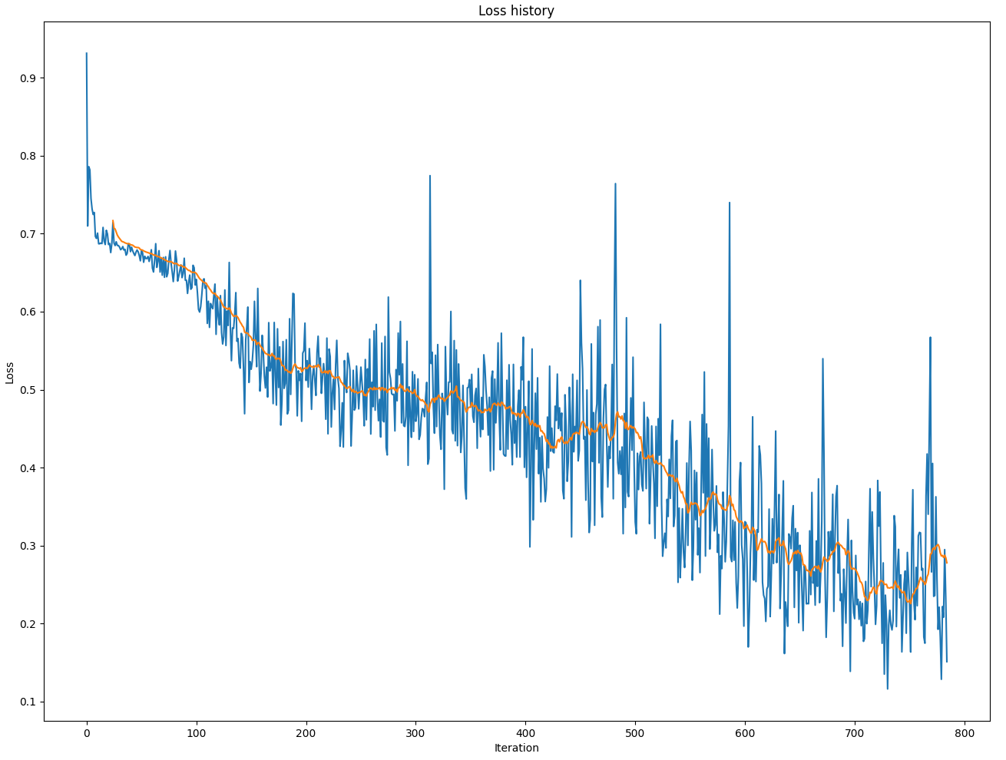
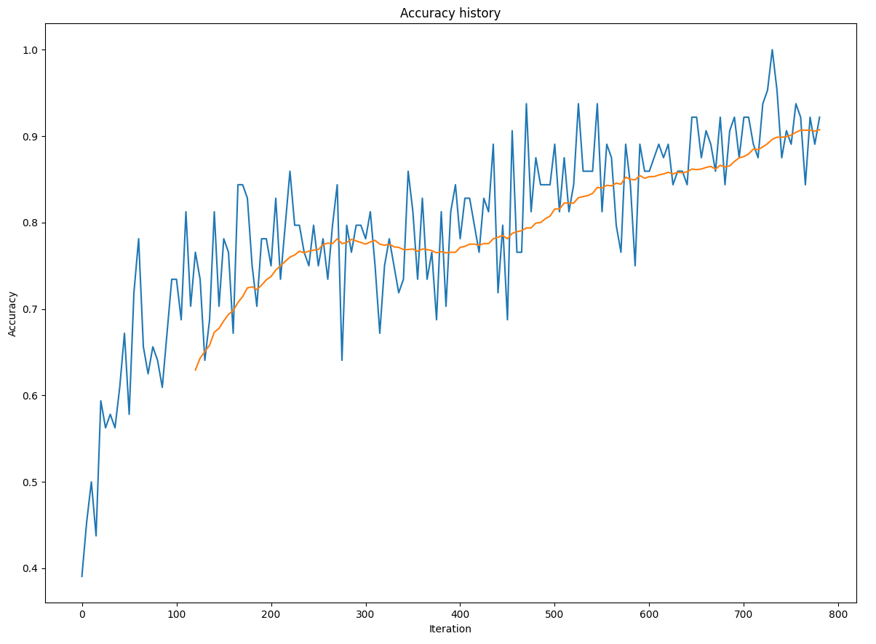
Training Results

Slide 23
Are transformers necessary for this example?
Probably not necessary for this example
Pooling ~ No “memory”
CNN ~ finite length memory
RNN ~ exponentially decaying memory
LSTM ~ double exponentially decaying memory
Transformers ~ "infinite" memory

Slide 24
Decoder Models
How to generate a sequence with transformer decoder models

Slide 25
Problem: How to predict the next step in a sequence?
"o" "r" " " "n" "o" "t"
Pooling
Dense
Encoder
"to be " "to be o" "to be or" "to be or " "to be or n" "to be or no"
Pre-processing
We can predict 1 or more steps ahead using the encoder. This approach requires a lot of repetition. Is there a better way?

Slide 26
Problem: How to predict the next step in a sequence?
"<s>to be or not to be..." "<s>to be or not to be..." "<s>to be or not to be..." "<s>to be or not to be..." --- "<s>to be or not to be..." "<s>to be or not to be..." "<s>to be or not to be..."
Dense
"to be or not to be…."
shifted target
Decoder
target mask
"to be or not to be..."
padding mask
"<s>to be or not to be..."
Pre-processing
0
memory
target
The decoder can learn all progression at the same time using masks.

Slide 27
Decoder Data
Dataset – Collected works of Shakespeare*
Problem
Blood and destruction shall be so in use
And dreadful objects so familiar
That mothers shall but smile when they behold
Their infants quarter'd with the hands of war
All pity choked with custom of fell deeds
And Caesar's spirit ranging for revenge
With Ate by his side come hot from hell
Shall in these confines with a monarch's voice
Cry "Havoc!" and let slip the dogs of war
That this foul deed shall smell above the earth
With carrion men groaning for burial.
Predict the next characters
*ocw.mit.edu/ans7870/6/6.006/s08/lecturenotes/files/t8.shakespeare.txt

Slide 28
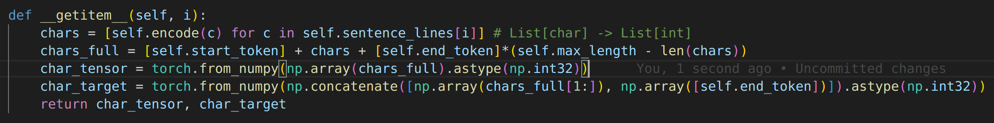
Decoder example
Dataset
Output shape: (1, max_length), (1, max_length)

Slide 29
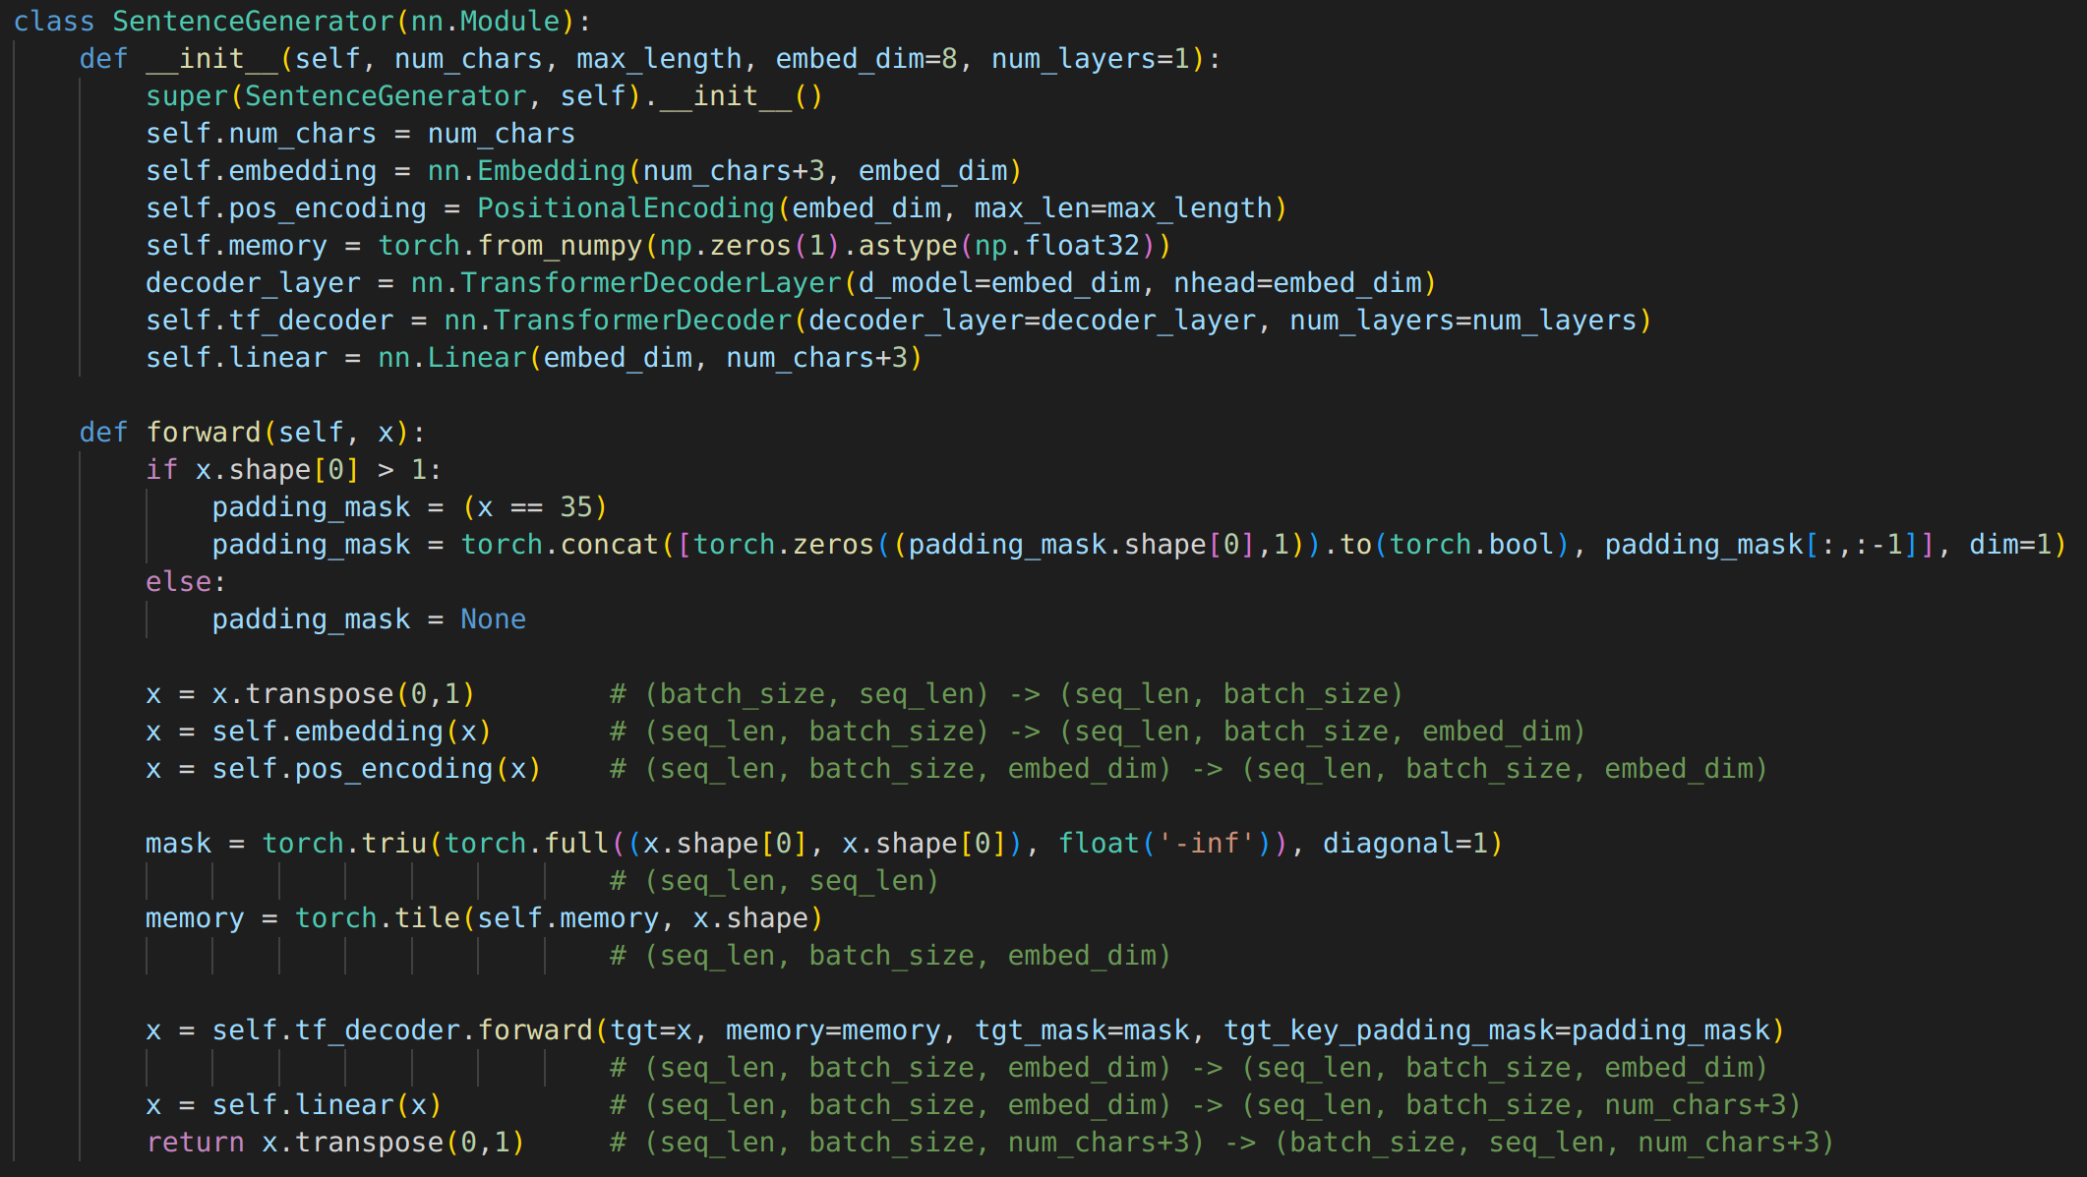
Decoder Model

Slide 30
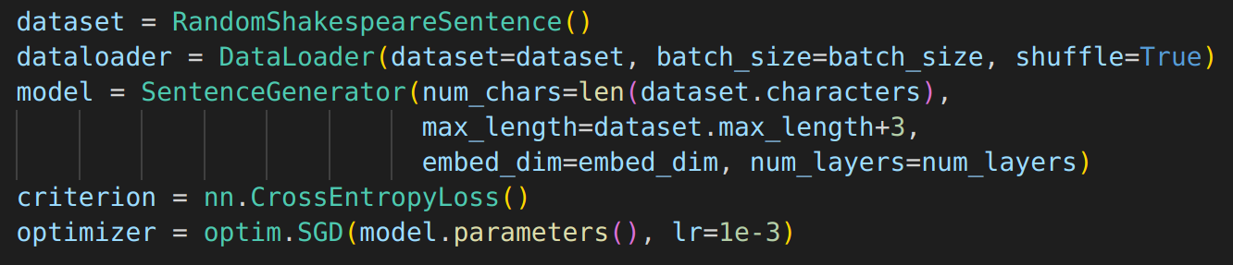
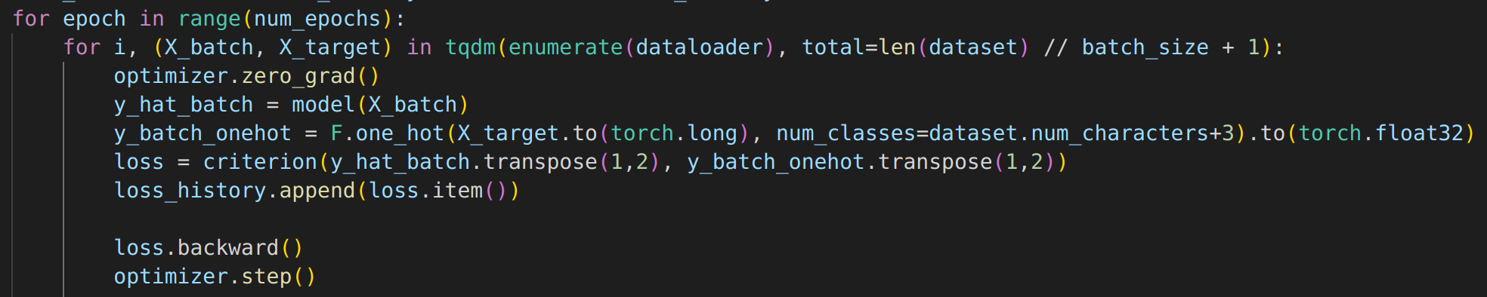
Decoder Training

Slide 31
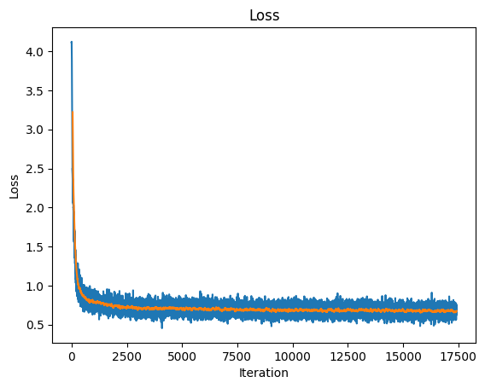
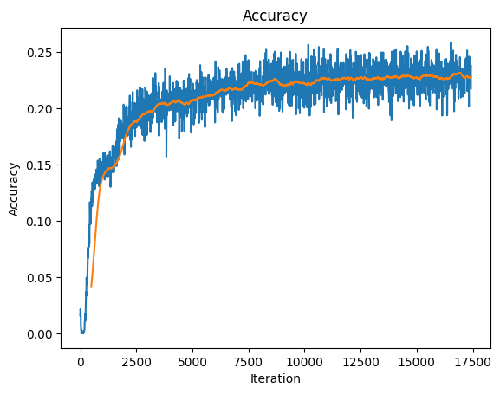
Decoder Results

Slide 32
Training results
Iteration 0:
"to be or not " "a horse! a horse! " "i " "" "welcome to data science festival! "
"tksksks?&&&&vvvvvvvvvvvvvvvvvvvvvvvvcf" "tks?&&&zvvvvvvvvvvvvvvvvvvvvvvvcf" "fff" "-z&&&&&&&&&&&&&&&&&&vp:&&vp:&&&vvvvvvvvvvvvvvvvvvcf" "ksks?vvvvvvvvvvcf"
Iteration 17500: "to be or not " "a horse! a horse! " "i " "" "welcome to data science festival! "
"the the the the the the the t the t the t t t t t the t the t " "the the the the t the t t the t the t the t the t the t t" "the the the the the the the the the the the t t the t the t the t the t t" "the the the the the the the the the the t t the t the t the t the t the t t" "t t the t the t the t the t t t t t the t"
Is this model underfitted or overfitted?
Training a slightly larger model with larger dimension and more layers gives a similar result. Language models needs to be quite large and be trained on a lot of data to produce realistic text, hence large pre-trained model are often preferable for NLP tasks.

Slide 33
Decoder Models for Timeseries Prediction

Slide 34
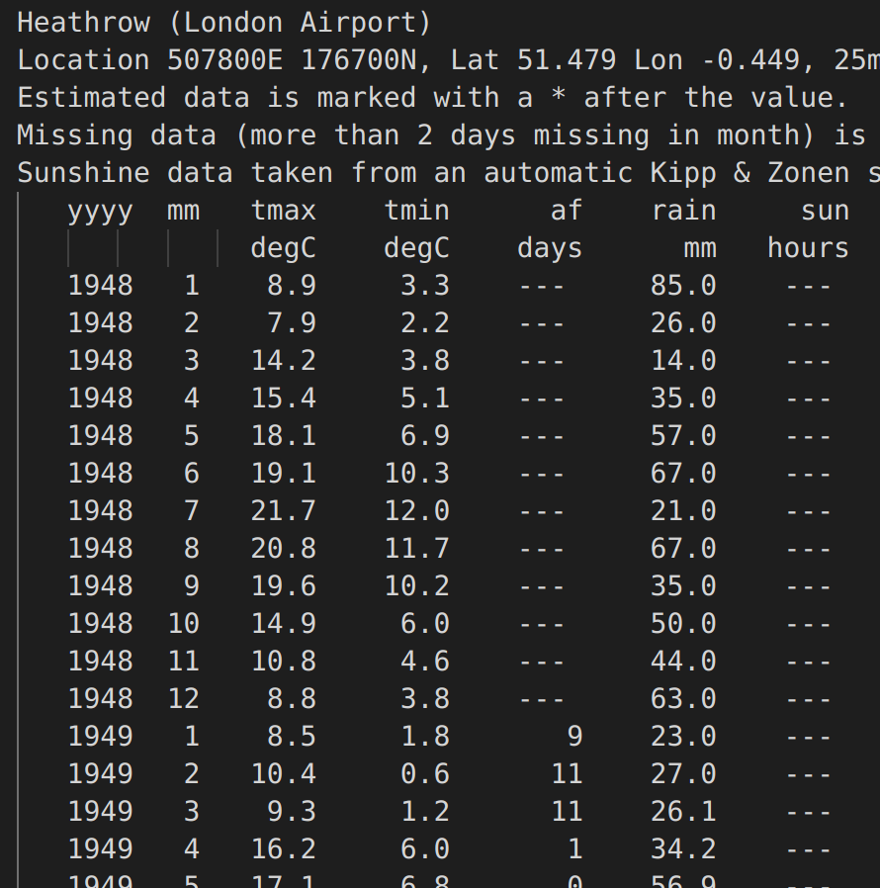
Timeseries Prediction Data
Monthly data of max and min temperature from Heathrow. Recorded by Metropolitan Office* since 1948.
Can we predict the temperature 3 months in the future?
Input: Month, last 24 months of tmax and tmin.
Output: tmax and tmin in 3 months.
*https://www.metoffice.gov.uk/pub/data/weather/uk/climate/stationdata/heathrowdata.txt

Slide 35
Problem: How to predict the next step in a sequence?
month[t+3:t+3+N]
Onehot
tmax[t+3:t+3+N], tmin[t+3:t+3+N]
Dense
Decoder
target mask
month[t-24:t+N] tmax[t-24:t+N] tmin[t-24:t+N]
Conv1d + Pos. encoding
0
memory

Slide 36
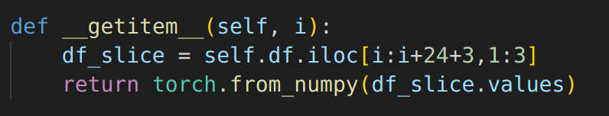
Timeseries Prediction Data

Slide 37
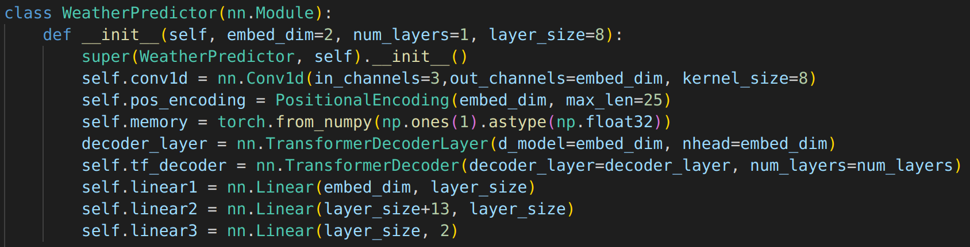
Timeseries Prediction Model

Slide 38
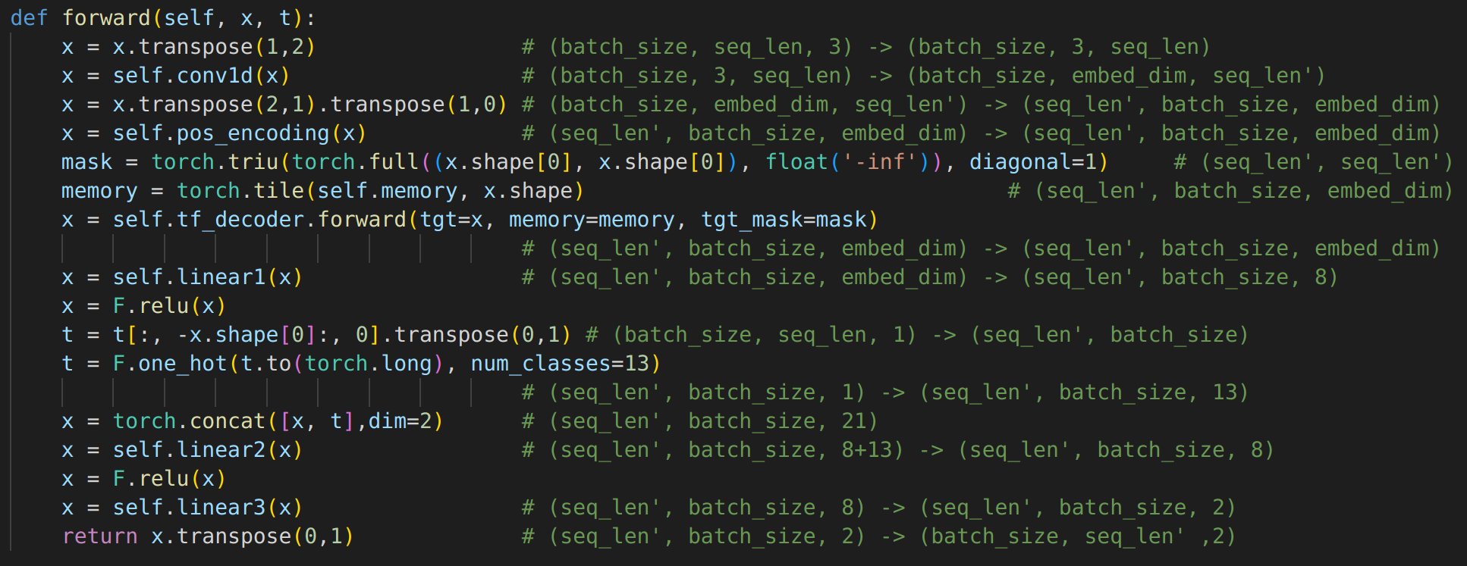
Timeseries Prediction Model

Slide 39
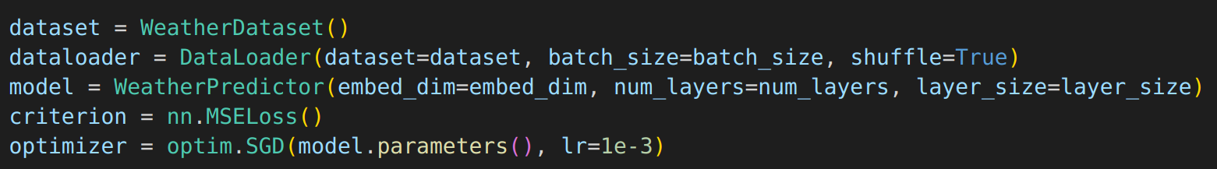
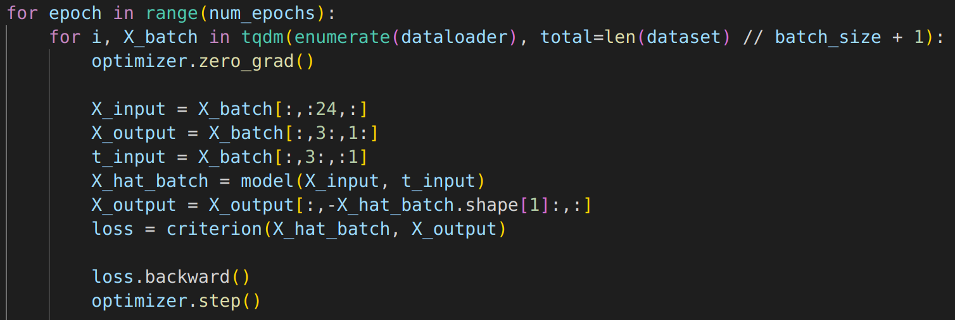
Timeseries Prediction Model Training

Slide 40
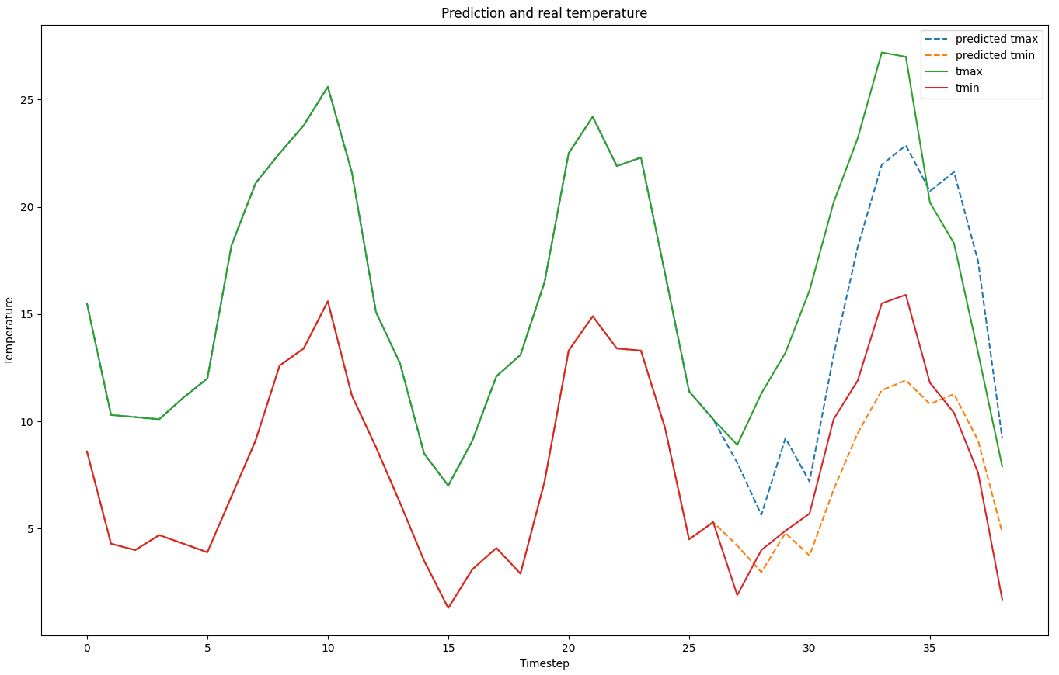
Training Results

Slide 41
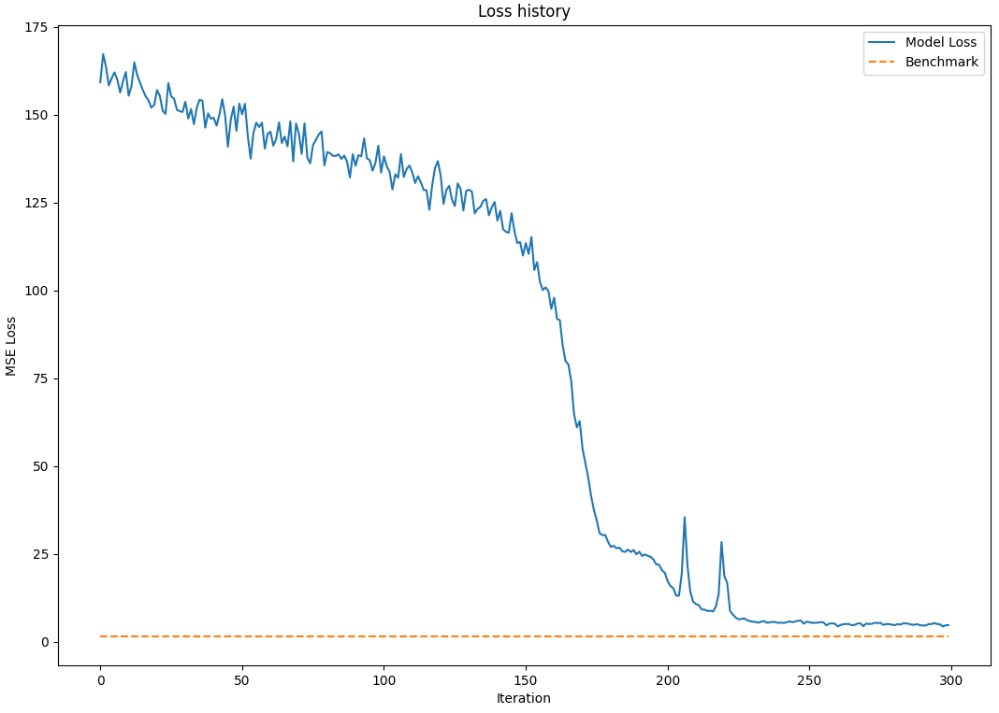
Training Results

Slide 42
Decoder with "memory"
What is the memory input?

Slide 43
Decoder Memory
Dense
shifted target
Decoder
target mask
target
Pre-processing
memory
In the standard Transformer model, the memory comes from the encoder. Memory is information/understanding about the sequence to generate. In practice, the memory can come from anywhere.

Slide 44
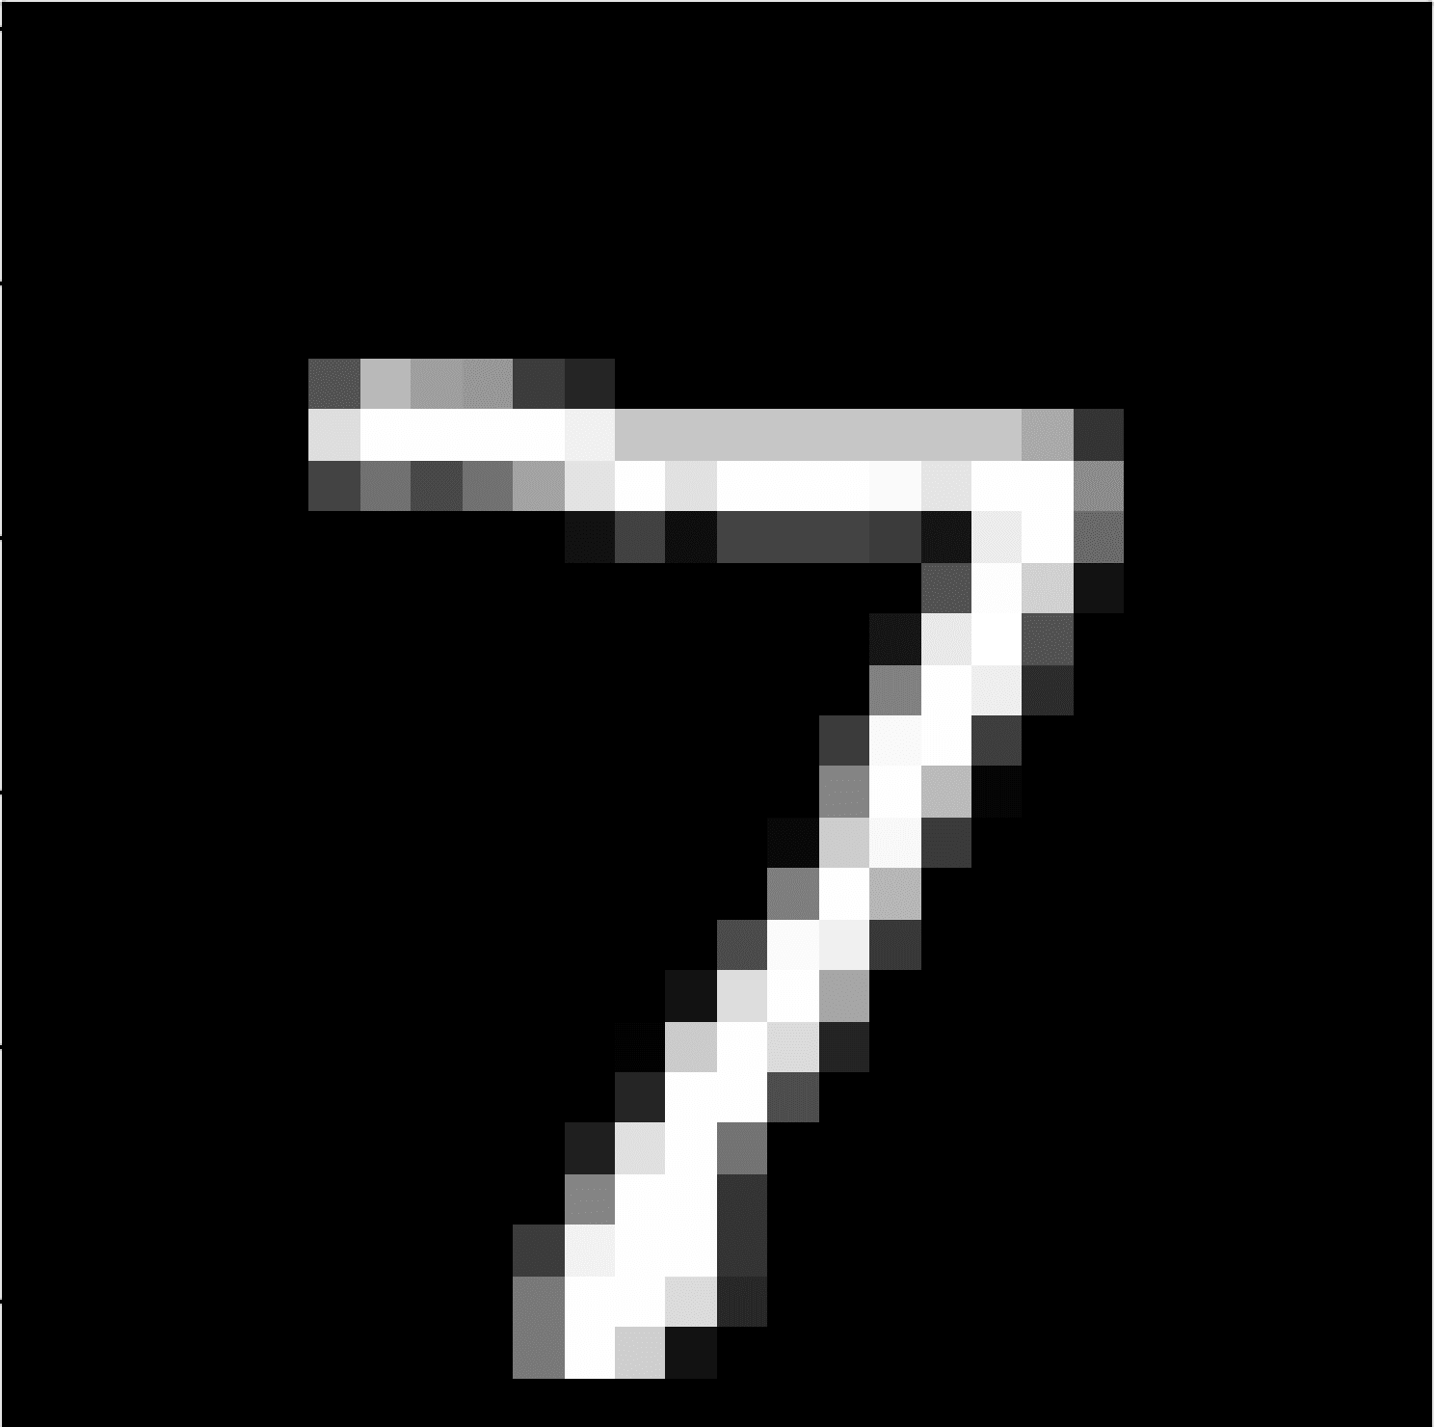
Decoder for Image Annotation
Dense
"seven…."
Decoder
"<s>seven..."
Pre-processing
CNN
memory
We can use memory for any other source, e.g. a CNN.

Slide 45
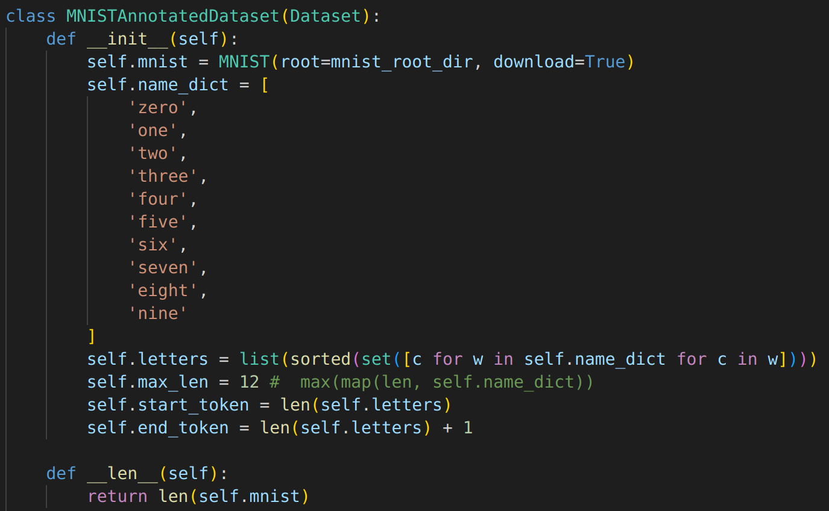
Image Annotation Data

Slide 46
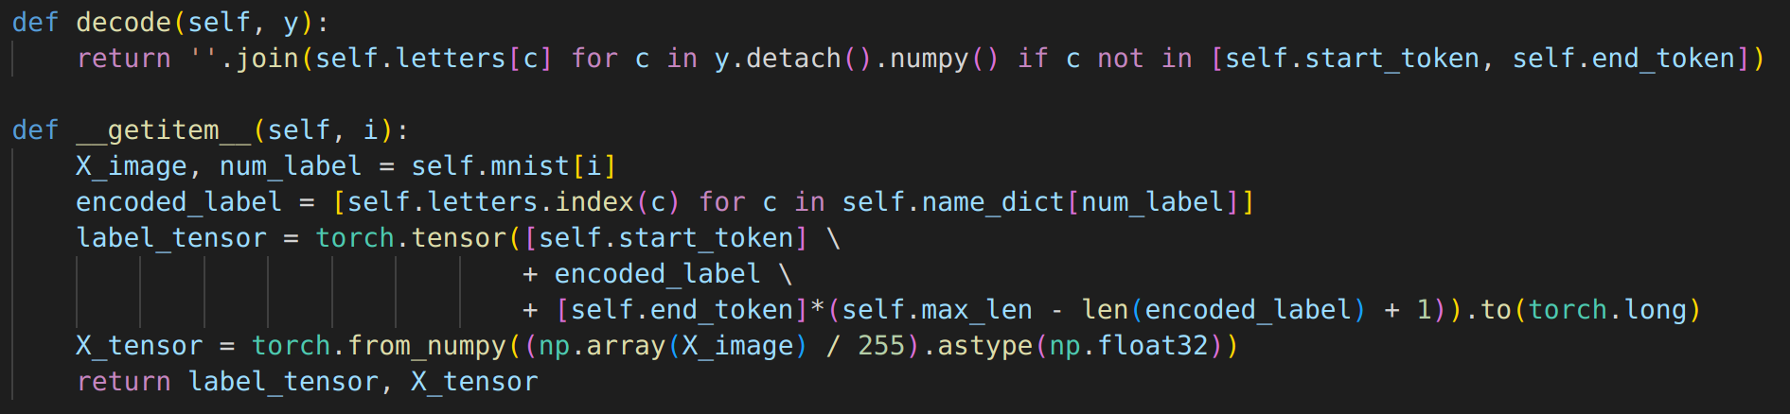
Image Annotation Data

Slide 47
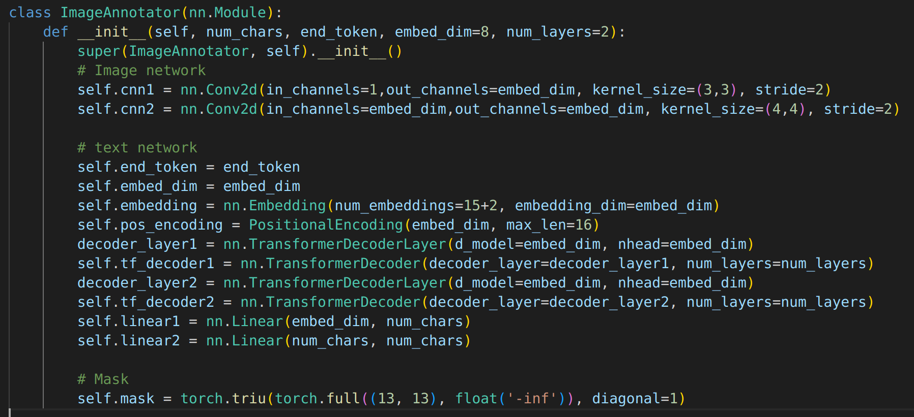
Image Annotation Model

Slide 48
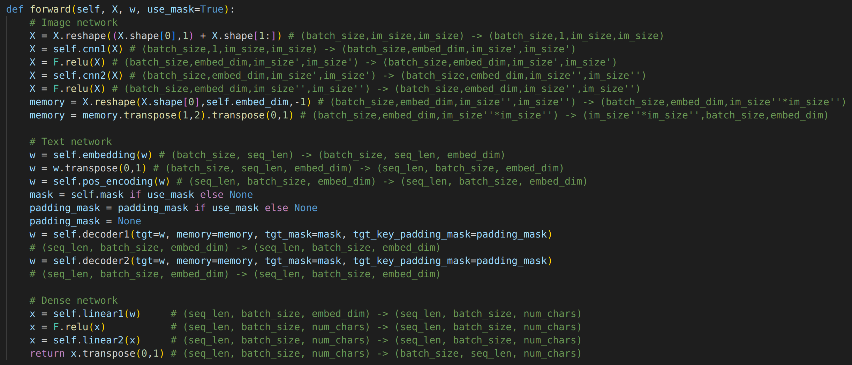
Image Annotation Model

Slide 49
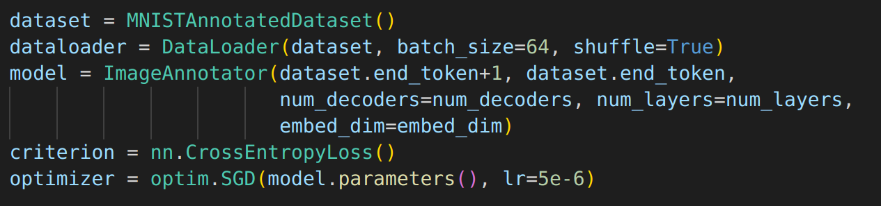
Image Annotation Training

Slide 50
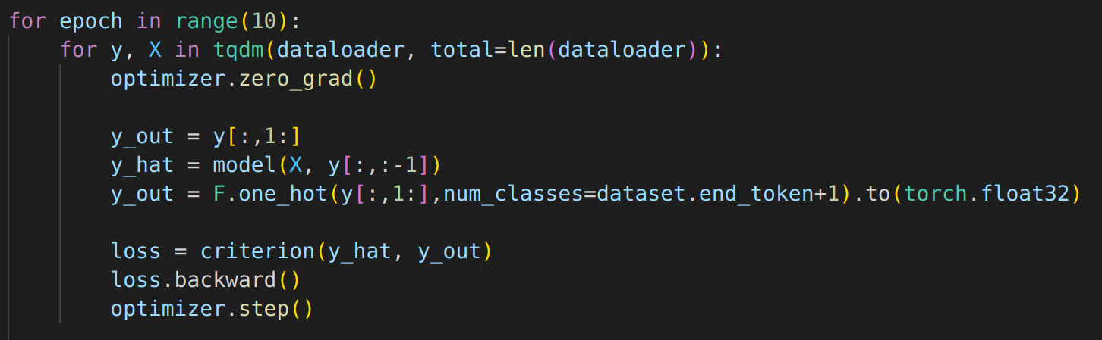
Image Annotation Training

Slide 51
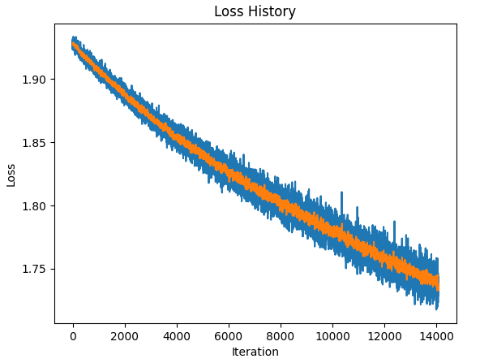
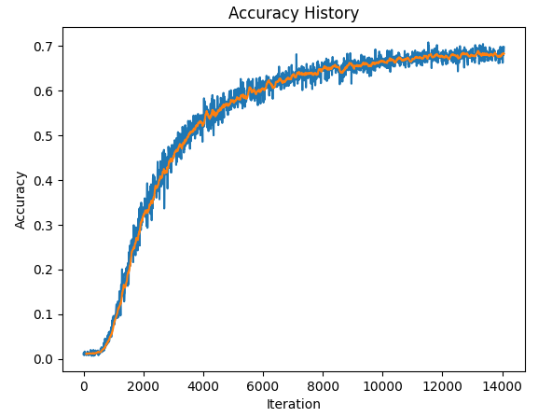
Training Results

Slide 52
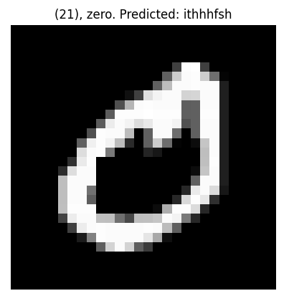
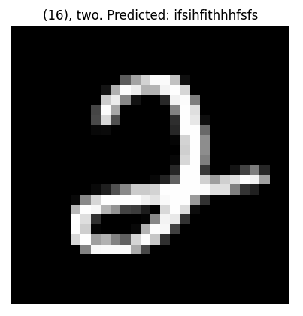
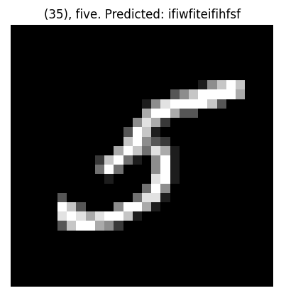
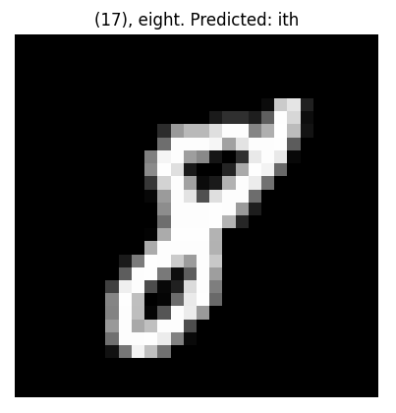
Training Results
xxe
t
t
t

Slide 53
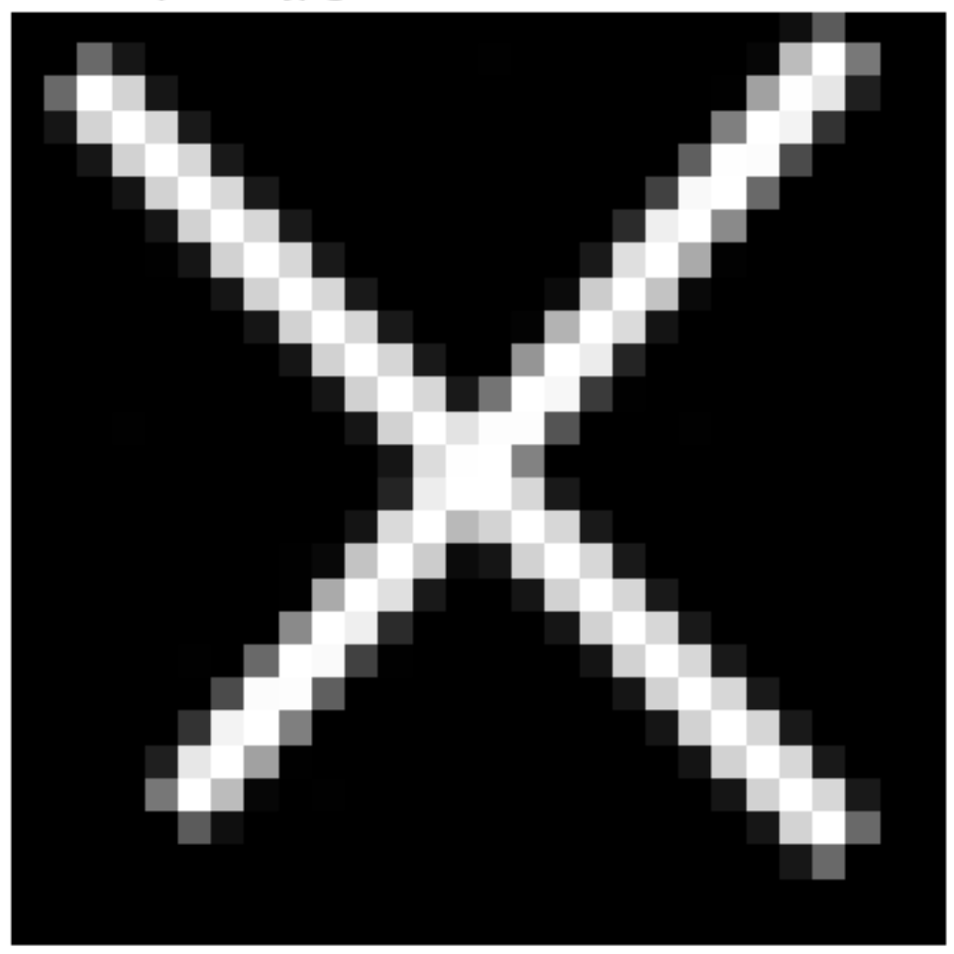

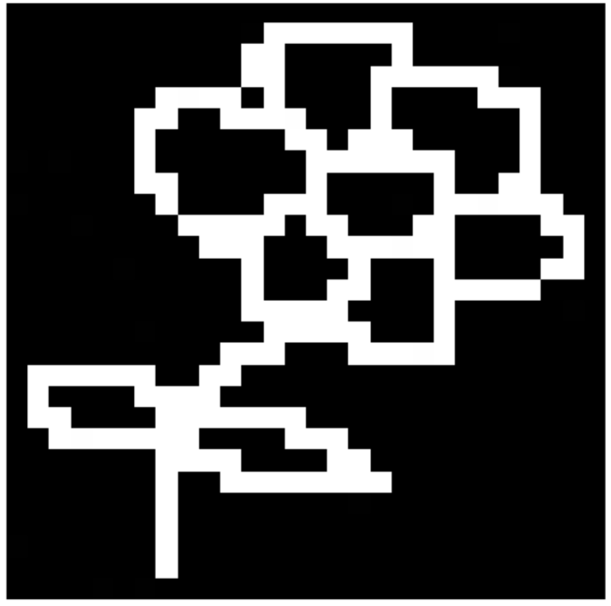
Training Results
t
t
xe

Slide 54
Conclusions
- Transformers are fun, but difficult to use properly.
- Language models need to be large to work properly. Therefore, pre-trained models are often preferable.
- We can go beyond the standard transformer architecture and combine transformers in new ways for new applications.

Slide 55
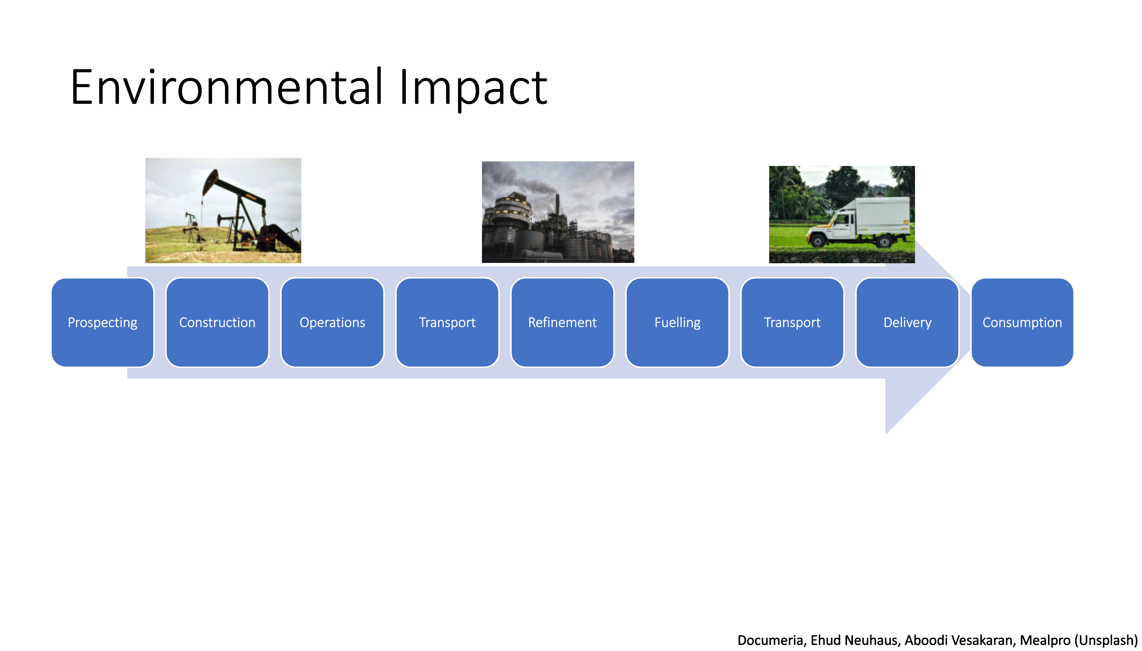

Slide 56
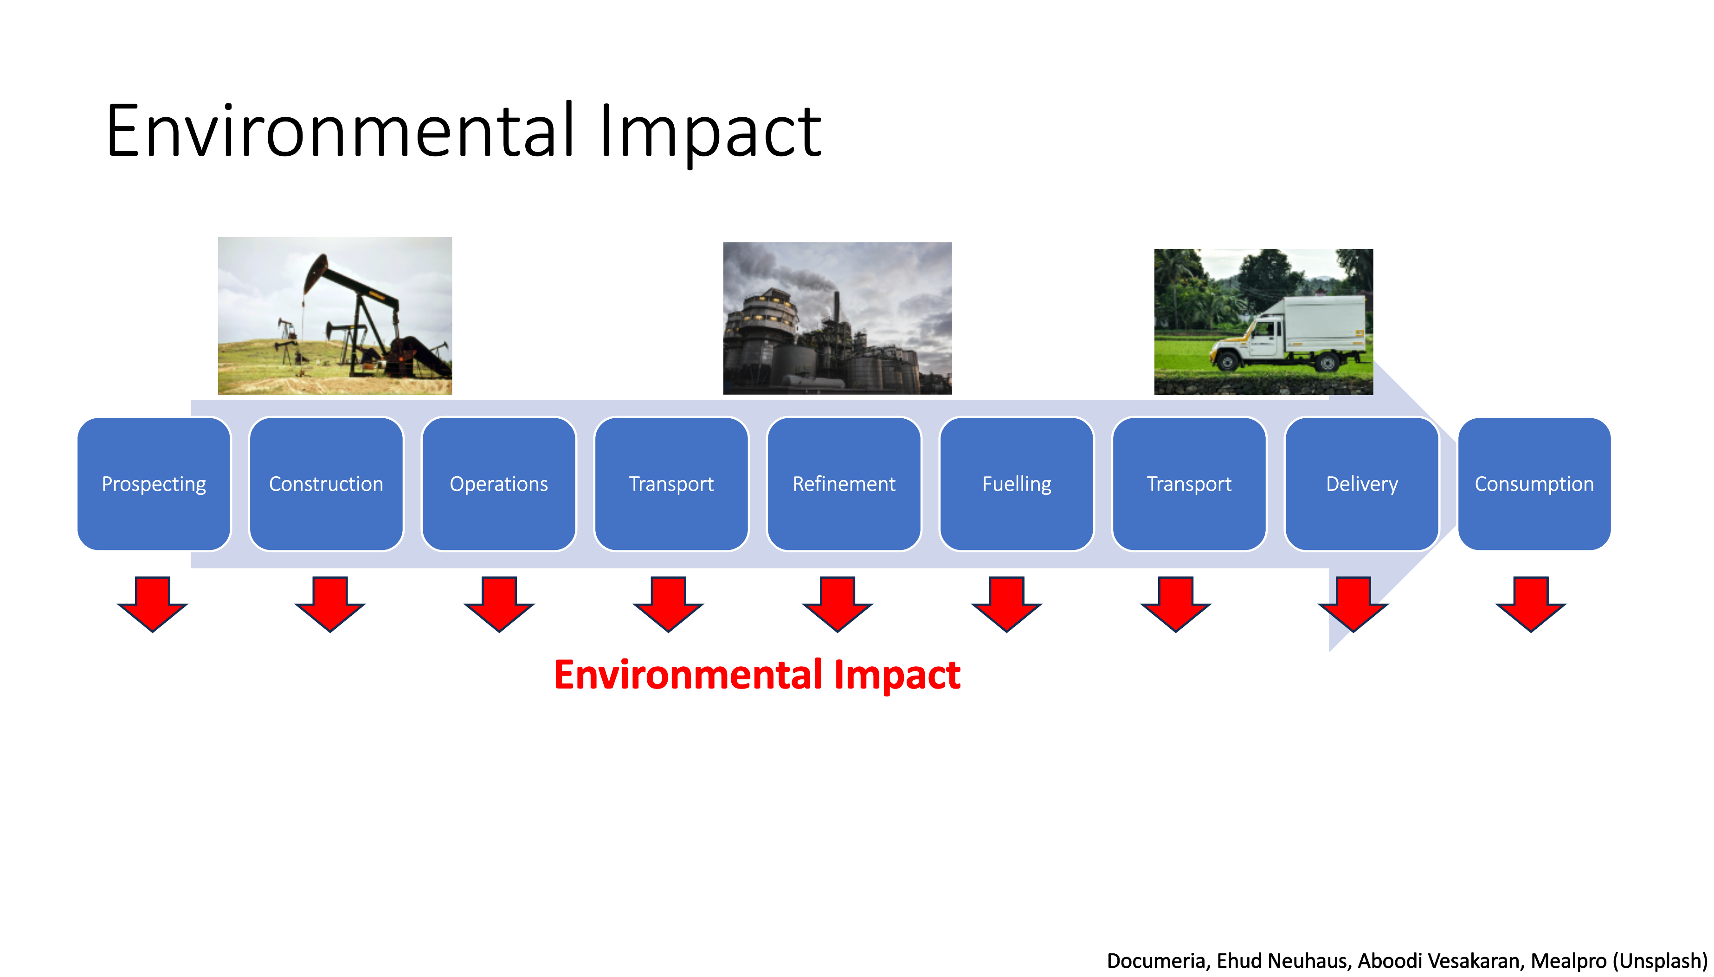

Slide 57
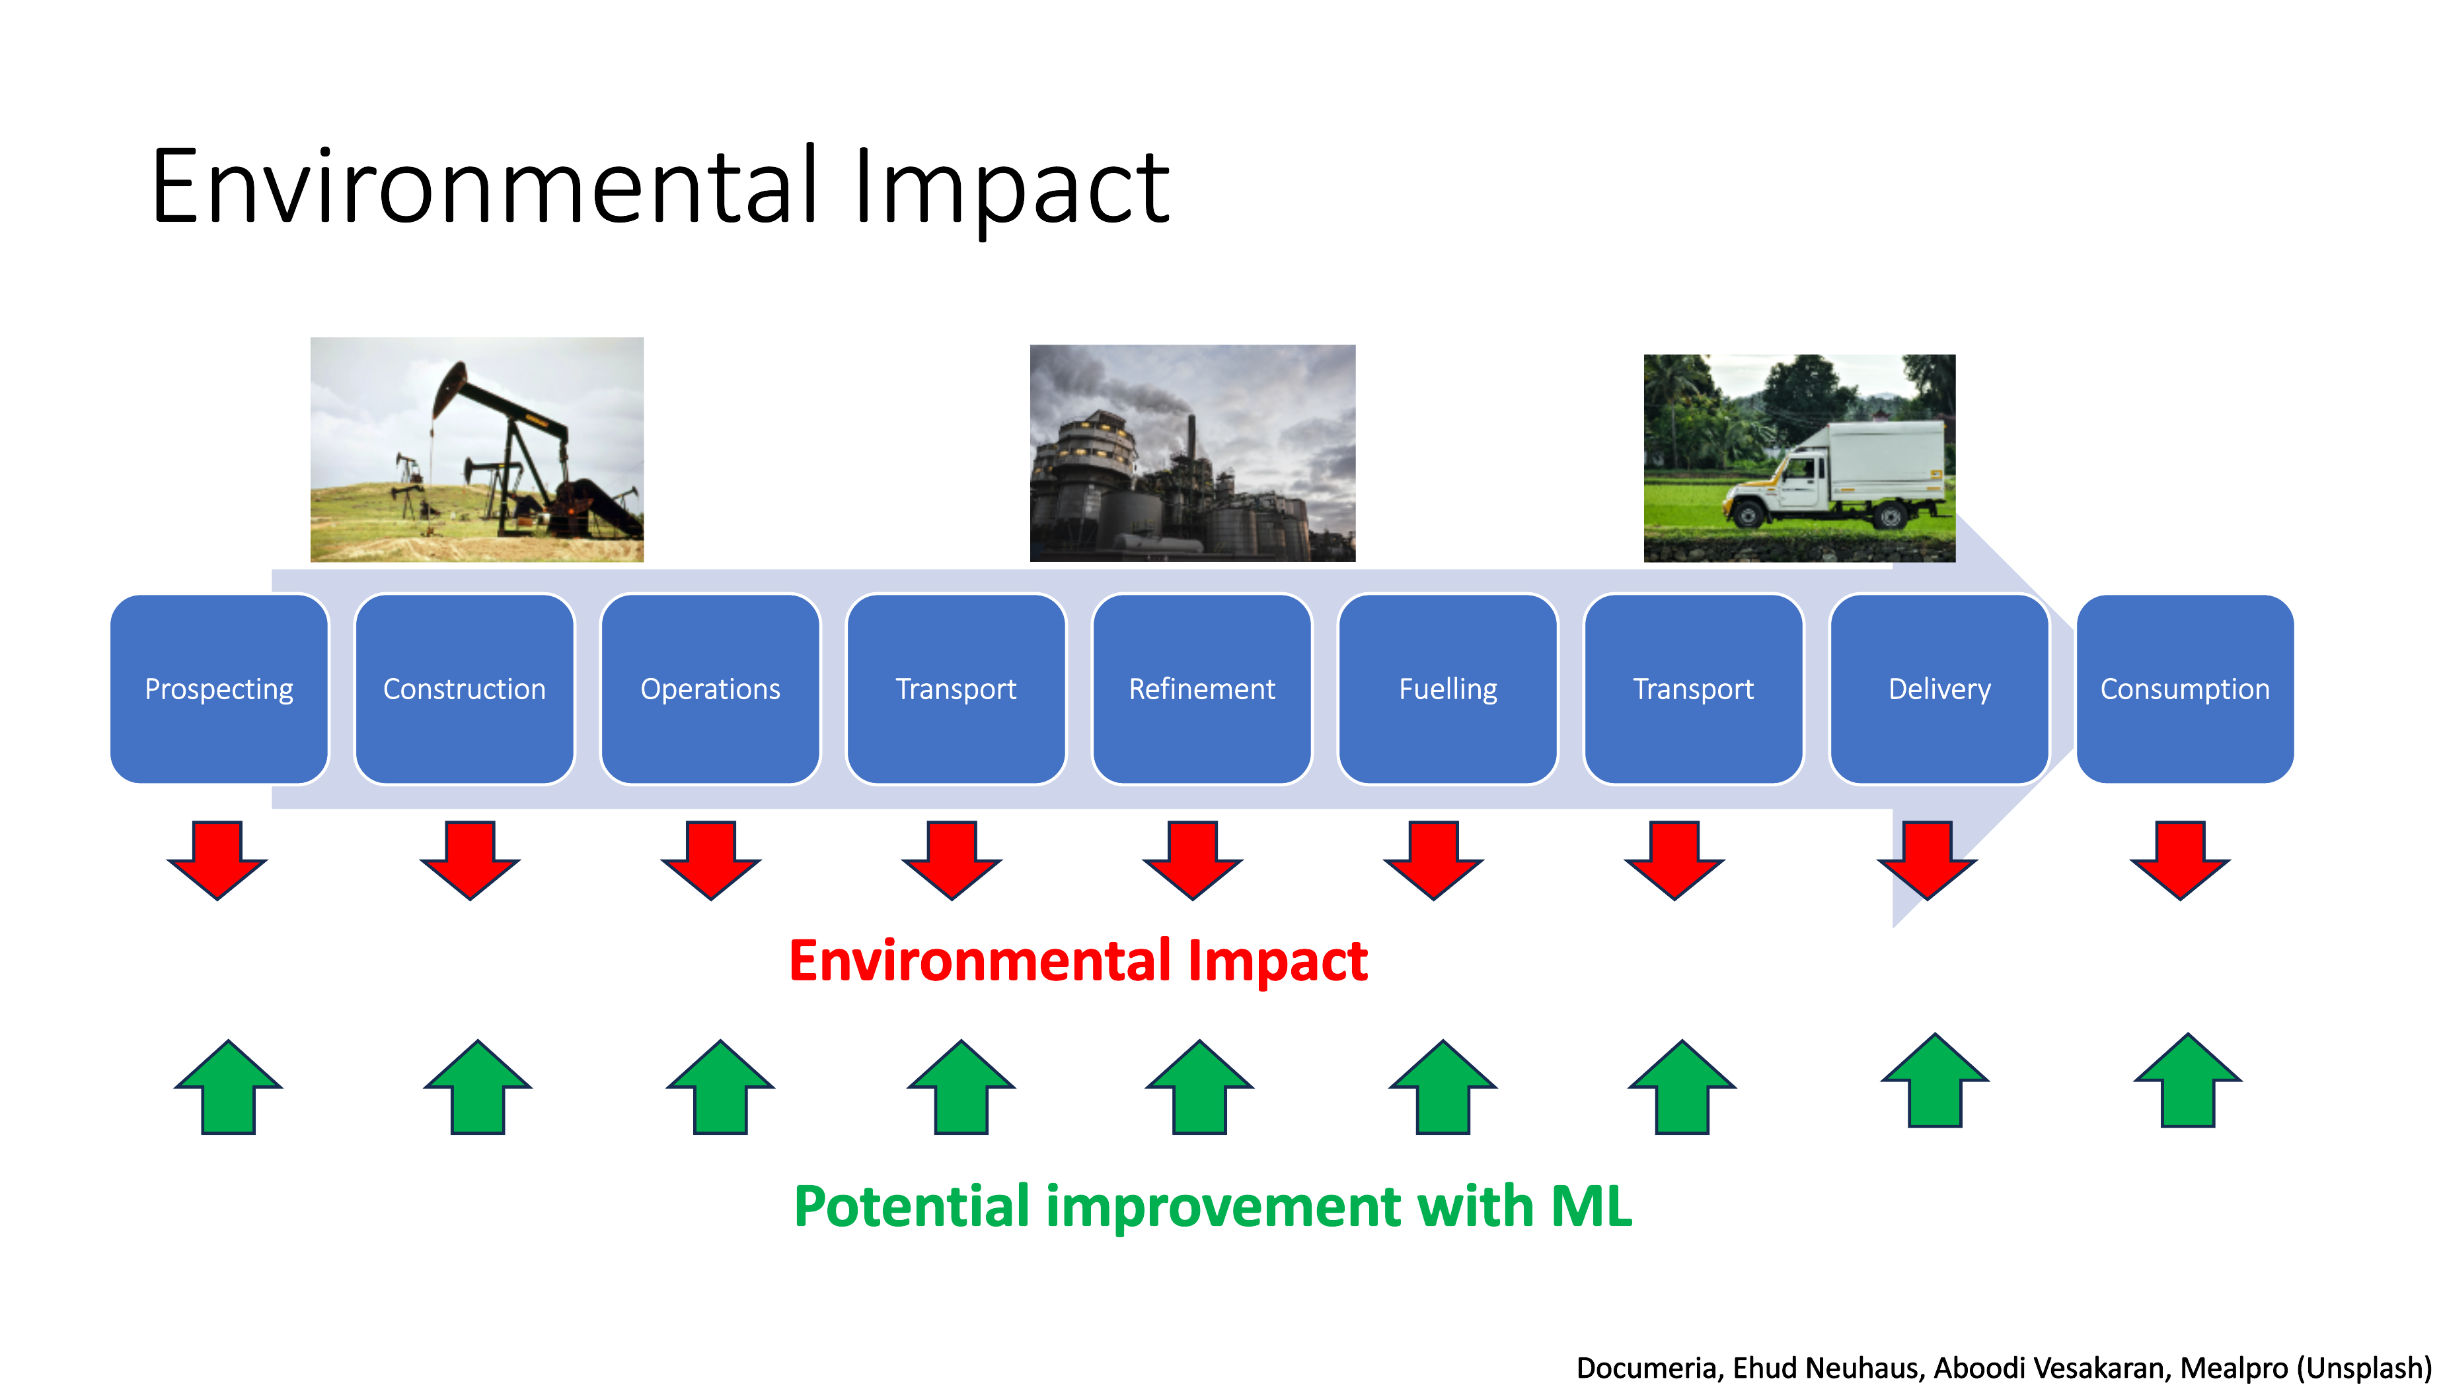

Slide 58
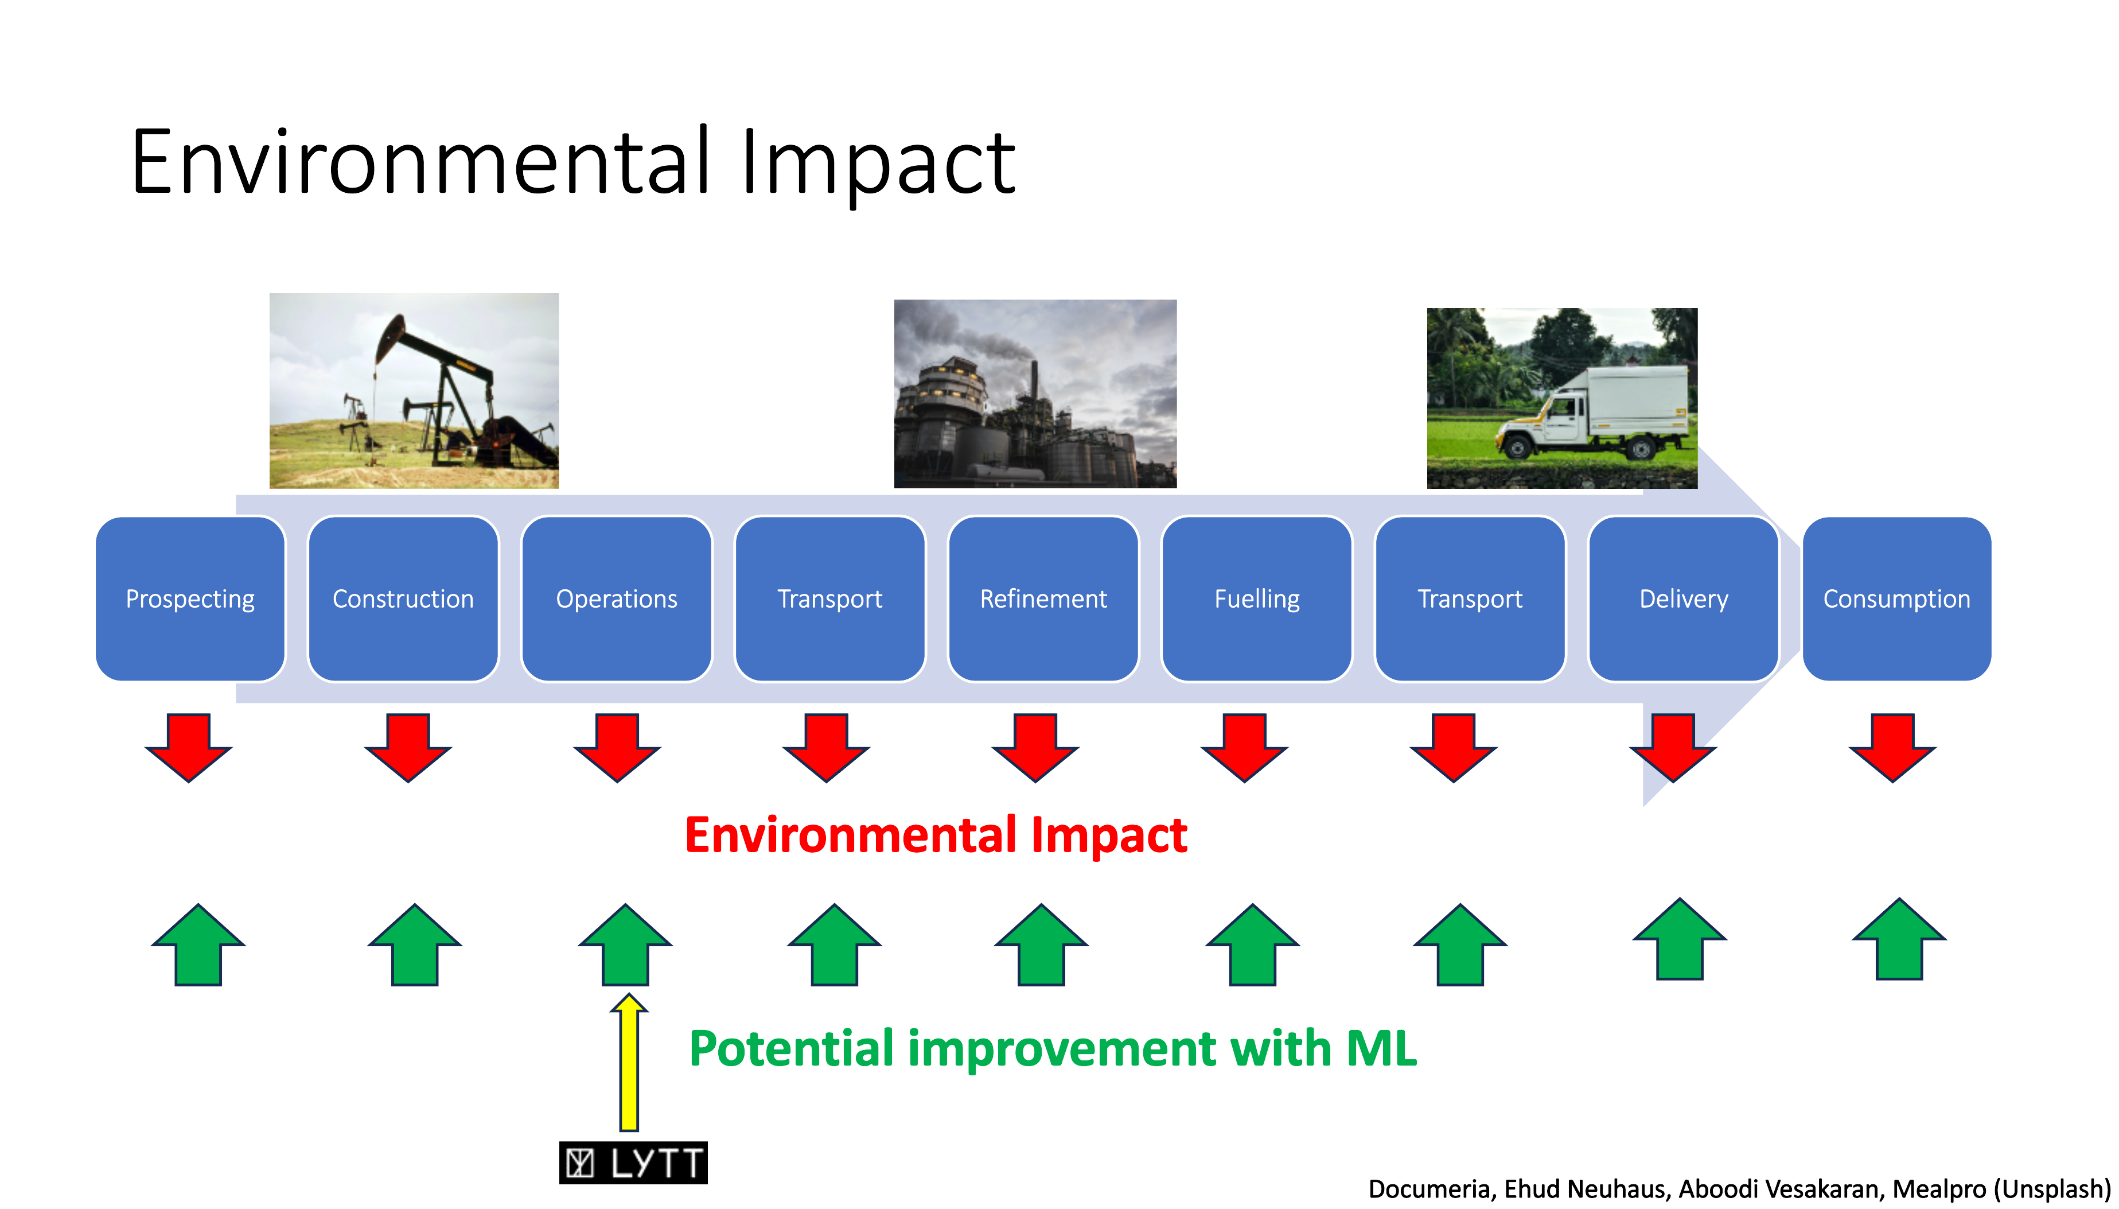

Slide 59
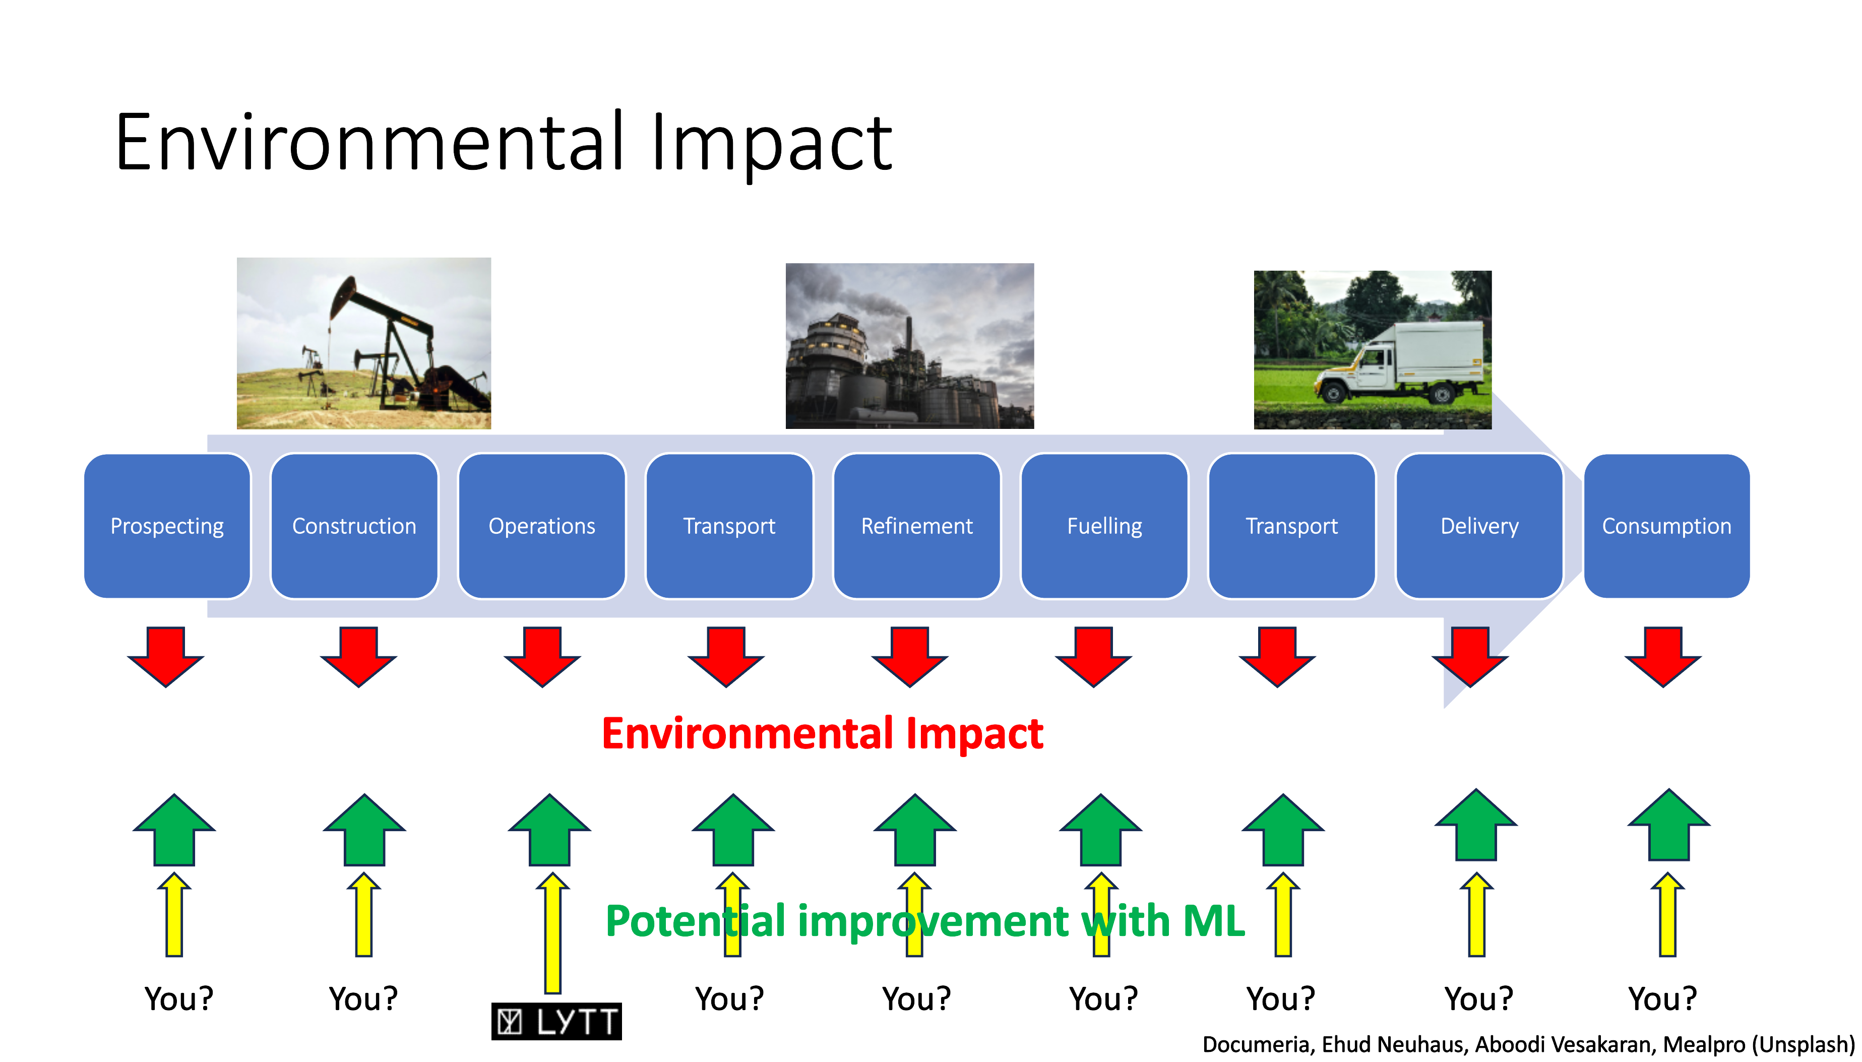

Slide 60
Thank you for listening!

